Slide 1





School: ............................................................................................................. Campus: .......................................................
Academic Year: ...................... Subject Name: ........................................................... Subject Code: ..........................
Semester: ............... Program: ........................................ Branch: ......................... Specialization: .......................... Date: .....................................
(Learning by Doing and Discovery)
PoW vs PoS – Consensus Mechanism Comparison
* Coding Phase: Pseudo Code / Flow Chart / Algorithm
Introduction:
The purpose of this lab is to create a timeline that highlights key events in the history of digital currencies. It will cover the journey from the first concepts of electronic money to modern cryptocurrencies. The timeline will include major milestones, technological innovations, and significant developments that shaped the growth of digital currencies. This will help us understand their origin, evolution, and current role in today’s world.
* Softwares used
Chrome web browser
Blockchain Explorer
Text Editor
1.Chrom Web Browser 2.Blockchain Explorers
3.Text Editor

Slide 2
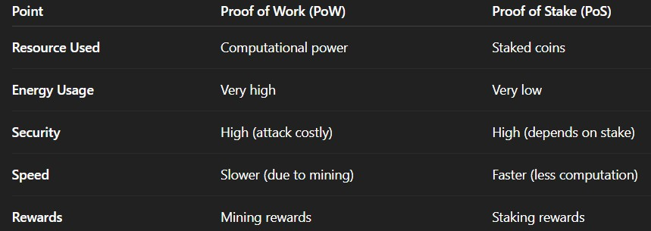
Applied and Action Learning
Implementation Phase: Final Output (no error
  Definition of Proof of Work (PoW)
Proof of Work is a consensus mechanism where miners solve complex mathematical puzzles (hashing) to validate transactions and create new blocks.
  Definition of Proof of Stake (PoS)
Proof of Stake is a consensus mechanism where validators are chosen to create and validate blocks based on the number of coins they stake (lock) in the network.
  Working Steps of PoW
Mining – Miners compete to solve a cryptographic puzzle.
Nonce Finding – Miners repeatedly change a random value (nonce) until the block hash meets the difficulty target.
Block Validation – The first miner to find the solution broadcasts the block, and other nodes verify it.
Working Steps of PoS
Validator Selection – Validators are chosen based on stake and randomization.
Block Proposal – The selected validator proposes a new block.
Finalization – Other validators check and confirm the block; once approved, it’s added to the blockchain.
(Comparison on Basic Points)

Slide 3
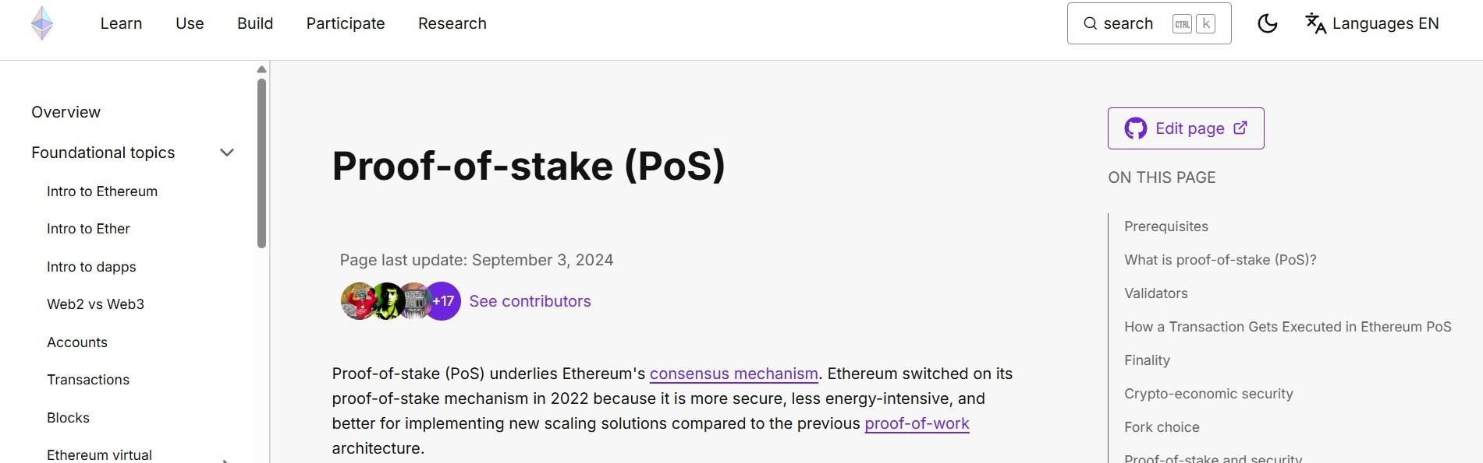

* Implementation Phase: Final Output (no error)
Applied and Action Learning
Conclusion
Summarize the main differences.
State that PoW offers strong security through computational cost, while PoS offers efficiency and lower environmental impact.
* Observations
PoW consumes high energy; PoS is energy-efficient.
PoW uses miners; PoS uses validators.
PoW relies on computational power to validate blocks, while PoS depends on the amount of cryptocurrency staked.
Rubrics
Concept | 10
Planning and Execution/ Practical Simulation/ Programming | 10
Result and Interpretation | 10
Record of Applied and Action Learning | 10
Viva | 10
Total | 50
Signature of the Student:
Signature of the Faculty:

